Slide 1


Salesforce Field Service training v1.3
Applicable as on 16/12/2022
Compiled by Chris Swart

Slide 2
Tasks handled by Admin
Set up site
Set up contacts – But you can edit them if need be
Set up systems
Set up services
Automation
Setting up most site visits
Sending out reports
Tasks for Service Personnel
Move scheduled site visits
Complete reports on time
Verify reports are correct
Update contacts

Slide 3
Lightning Login
Auto Scheduler
Set up Site Visits
Set up Jobs
Transfer Site Visits
HCC, LEG, COR CAR
Fill in Youreka on jobsite
Fill in Youreka at desk
System Charts
Checking limits
Uploading documents
Resubmitting

Slide 4
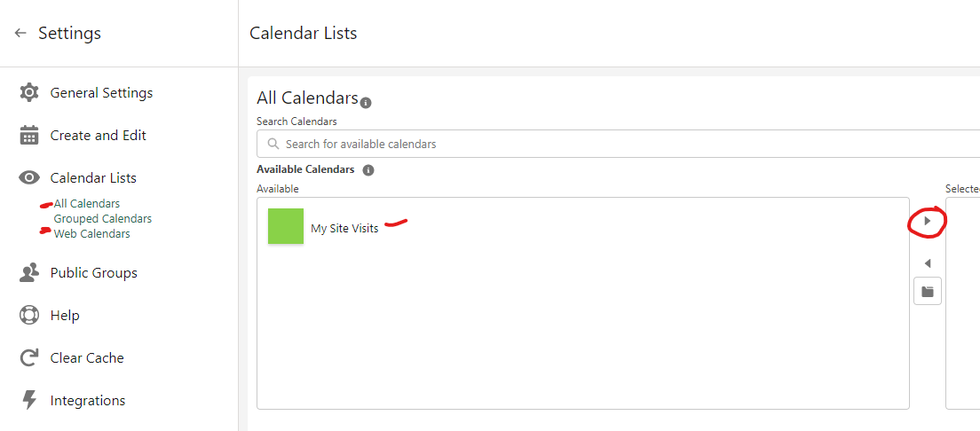
To access the new Calendar plugin, go to the CalendarAnything tab, not the previous Calendar tab
Click the gear icon
Next go to Calendar Lists, All Calendars and move My Site Visits over with the arrow.
Do the same for any Web Calendars

Slide 6


2 Factor Authentication
Each account needs to have 2FA set up
Download the Salesforce Authenticator app.
On iTunes it is not always the first result
Add account on Authenticator
Use the two words given on the app as the two words Salesforce asks for
Notes:
Send link to everyone

Slide 7
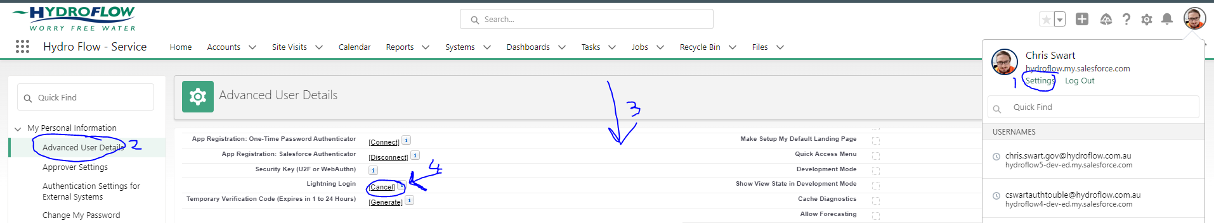
Lightning Login
Lightning Login lets you log in without using a password
Each user needs to enrol themselves; I cannot do it for you
Download Salesforce Authenticator app
Go to settings and enrol
https://salesforce.vidyard.com/watch/Pk8QwpPk9QguuzZPtVh5dR
Notes:
Send link to everyone

Slide 8
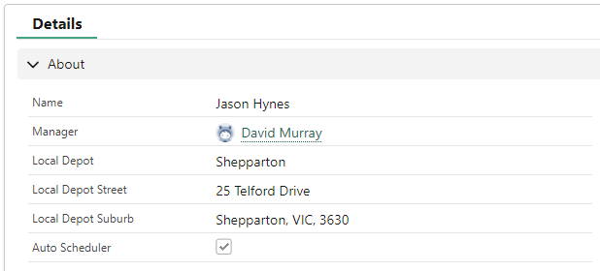
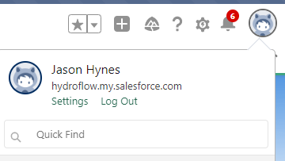
Auto Scheduler
If you are subscribed to the Auto Scheduler, it will run the last Monday of each month
Site visits will be scheduled on the Wednesday for the week it is set up for
To change the weekly setup, see the next slide
To check if you are, go to your profile page (image in the corner).
To register, contact cswart@hydroflow.com.au
New Personnel are automatically registered
Notes:
Send link to everyone

Slide 9
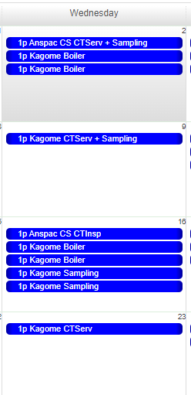
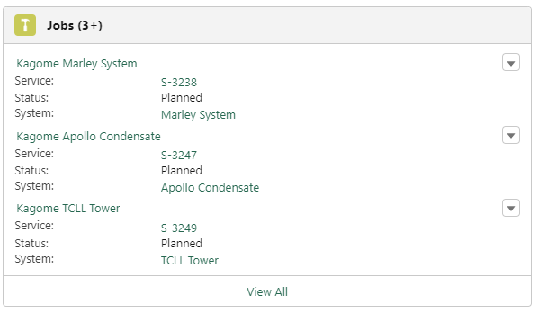
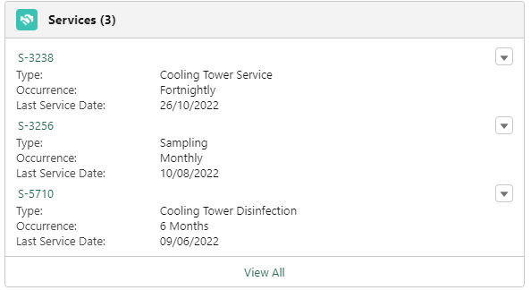
To change the weekly setup
For this example, we want to change the Monthly sampling to occur on Week 3.
Go to the Service page, either directly, or via the Jobs or System pages.
Here we go to the site visit, select the System Name (Marley) and then go to the Service page (S-3256).

Slide 10
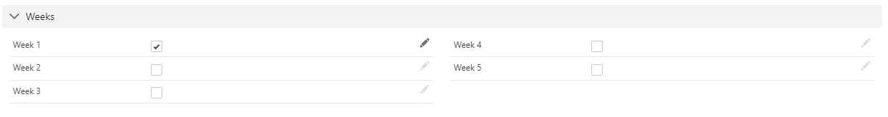

To change the weekly setup (Continued)
Click the pencil icon to edit
Tick the correct week
Untick the incorrect week
Save
This can also be done to move CT Services
Note that fortnightly services will all be set up for Week 1 and Week 3, if you need it to occur on Week 5 too, tick that option

Slide 11
Set up Site Visits
Preferably only use this for ad-hoc site visits
Use the calendar,
A site visit needs to be created for every time you go to site. This may recur daily, weekly, monthly etc.
If someone else needs to go on your behalf, the owner can be changed.

Slide 12
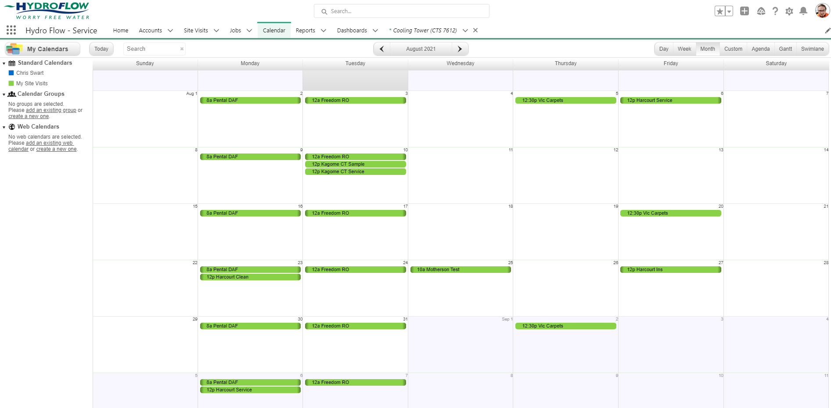
Go to Calendar and make sure “My Site Visits” is selected

Slide 13
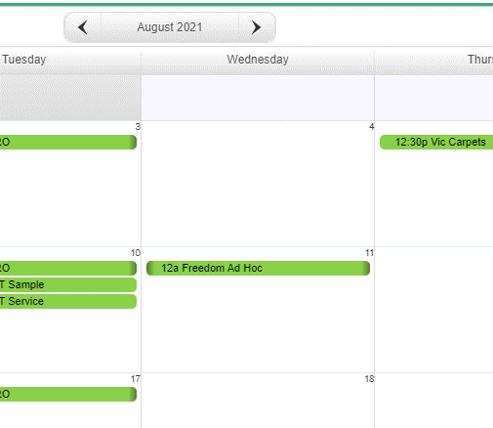
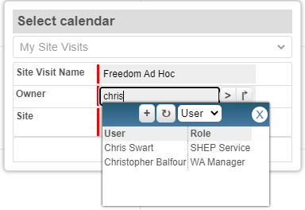
To create a new site visit, click on the day you want
Choose a concise yet descriptive name
Make sure the Owner is set to User and not

Slide 14
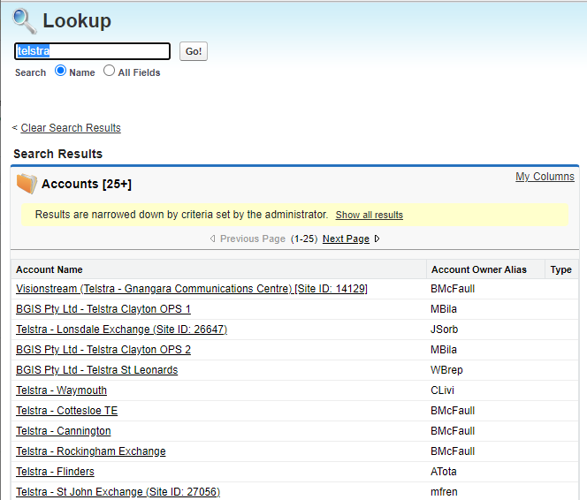
Lookup the account name
This will show all accounts, not just yours, so choose carefully

Slide 15
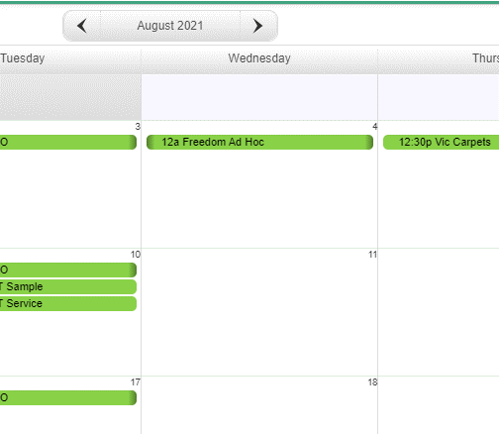
To move a site visit, click and drag it to its new day
All Jobs will move too
This will not change the time

Slide 16
Scheduling Jobs
A new job needs to be created for everything you do on site.
Thus 1 job for service, 1 job for coupons, 1 job for sampling, 1 job for disinfection, 1 job for cleans etc.
Sites with multiple towers will have many jobs on one visit.

Slide 17
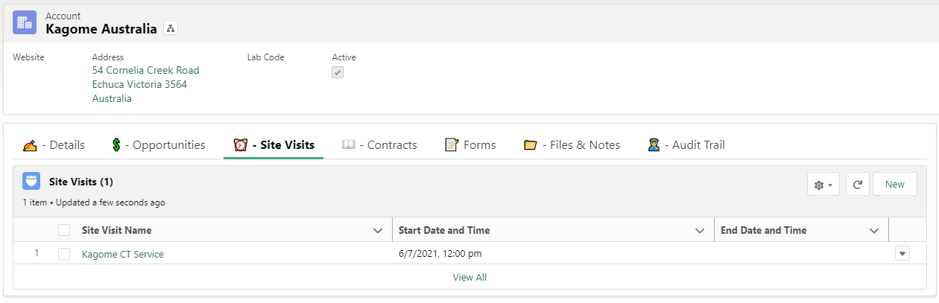
Click on your Site Visit in the Account page, or click on it from the Calendar
Notes:
Calendar is easier, but this is just another way

Slide 18


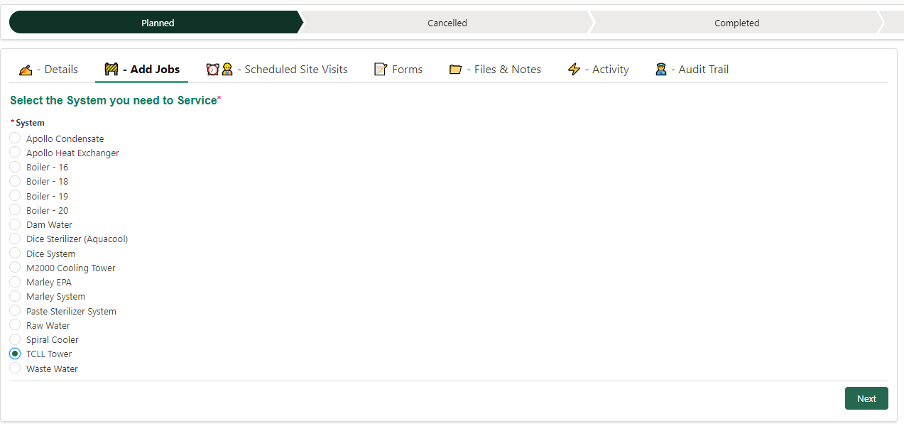
Go to the tab, choose the system you are creating a job for and press

Slide 19
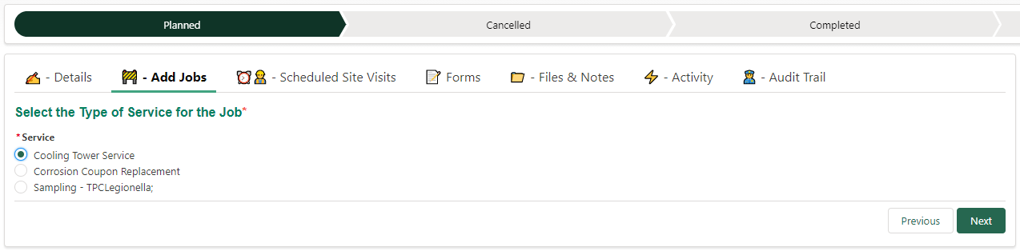
Select the type of service, inspection, sampling etc, and press
Note: If a service type isn’t available, contact your admin email and let them know
Notes:
No CTC/Disinfection? Let Admin know

Slide 20
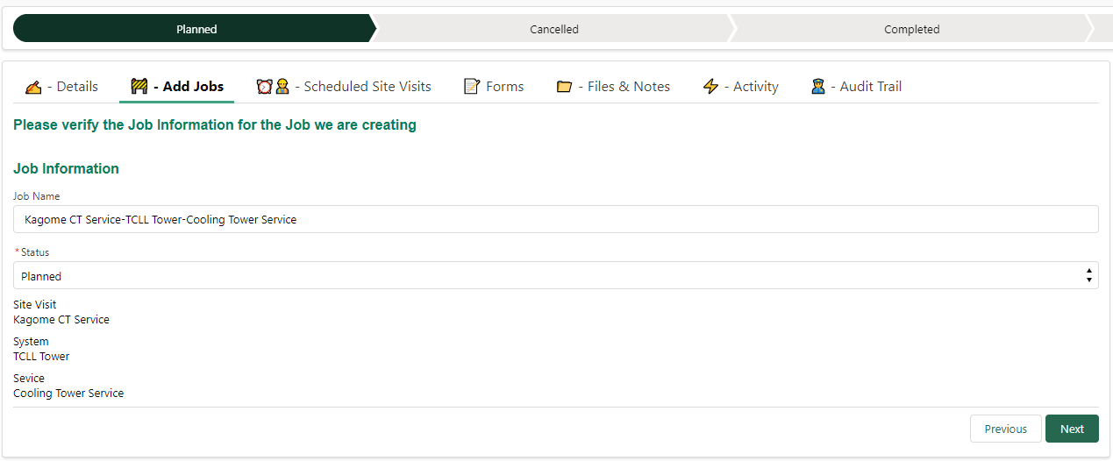
Verify and press

Slide 21
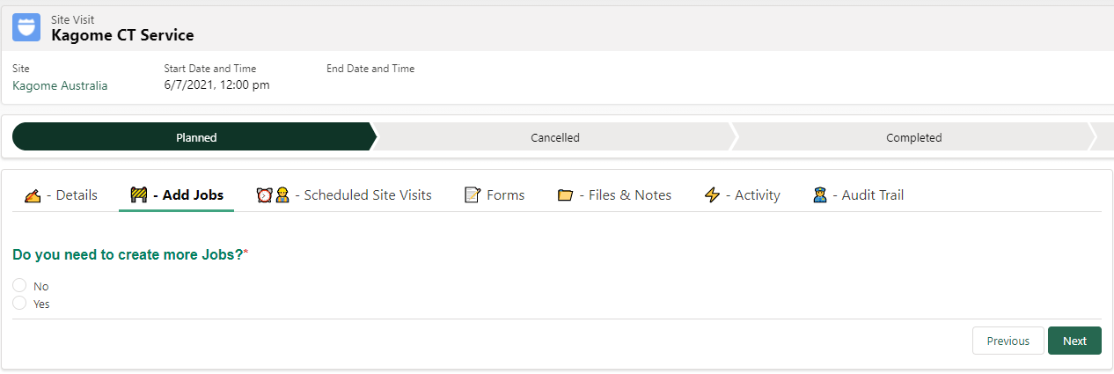
If more jobs needs to be added to this visit, choose yes, then
Remember to add the samplings and disinfections where needed.

Slide 22
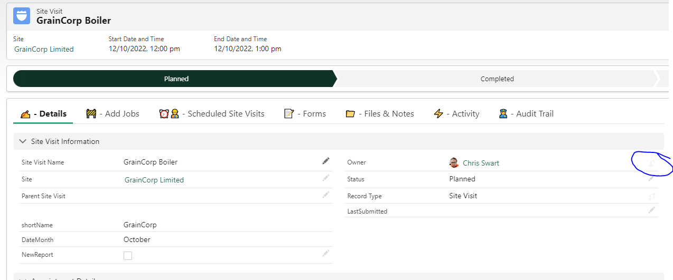
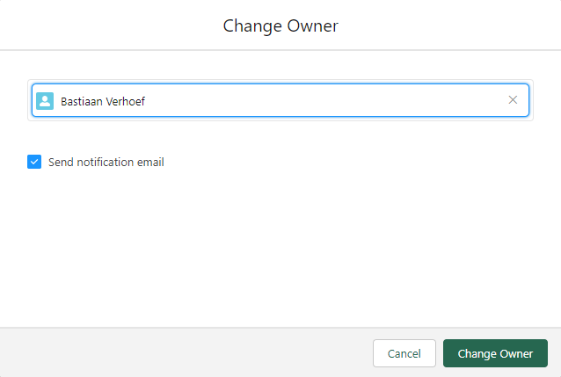
Delegating
Delegating site visits
If someone else is doing a job on your behalf, you need to assign the job to them before it will appear on their Youreka app.
Notes:
The button is sometimes almost invisible. Send notification if needed

Slide 23
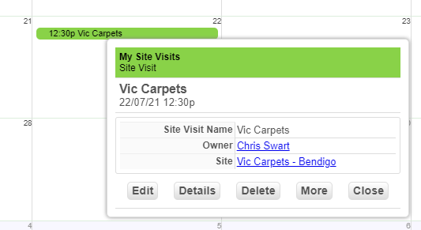
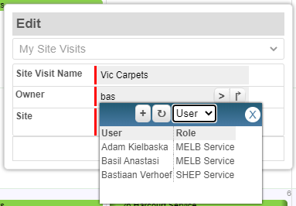
Delegating site visits
Click on the site visit you want to delegate
Click and type the new owner's name
Make sure the Owner is set to User and not
Click on
This will delegate one site visit only, not all recurring
Notes:
Just another way to Delegate

Slide 24
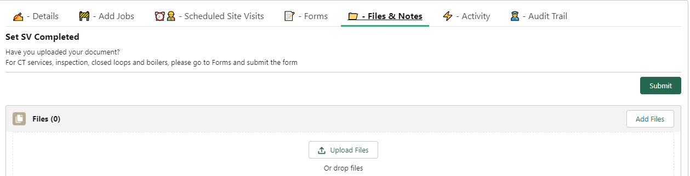
Corrective Action Reports
Charisse schedules 3 jobs:
Disinfection on the day (move it to the next day if needed)
Resample 5 days later (again, move if needed)
CAR which is just a spot to upload your completed CAR
Submit after uploading your PDF

Slide 25


On your phone
Youreka New is the preferred app
As Youreka Mobile will be shut down later this year

Slide 26
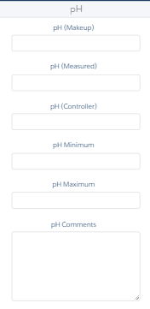
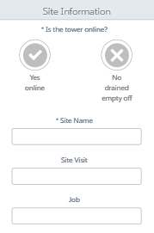
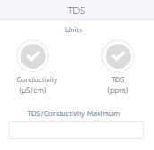
Notes:
If the tower is offline and you click no, a checkbox will appear that needs to be unticked

Slide 27
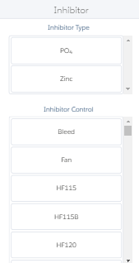
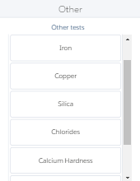
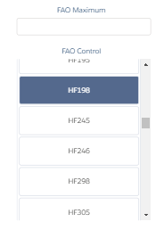
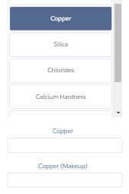

Slide 28
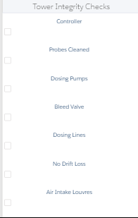
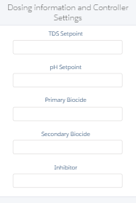
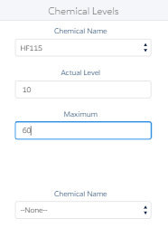
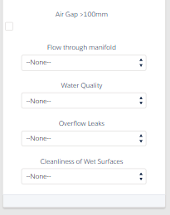
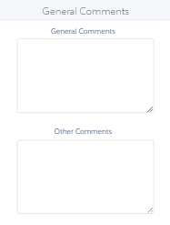
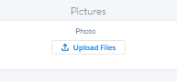

Slide 29
At your desk

Slide 30
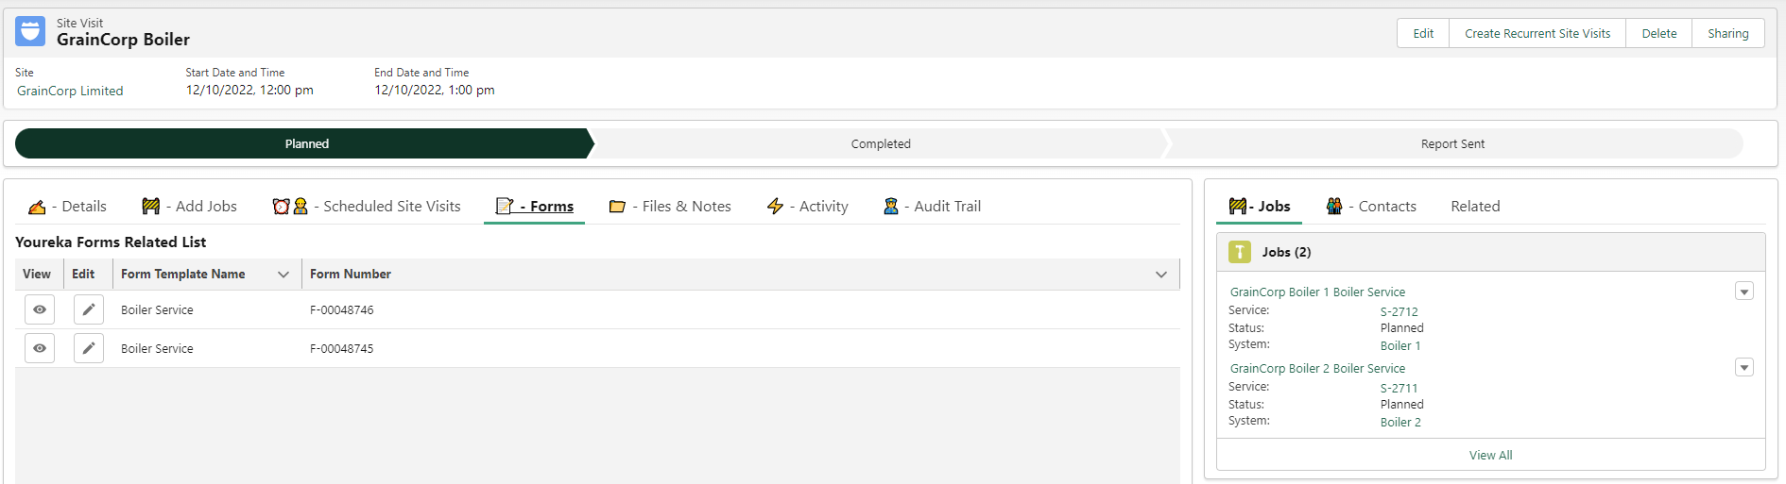
Note that this step looks a little different currently due to a bug in Youreka. They hope to have a fix available soon

Slide 31
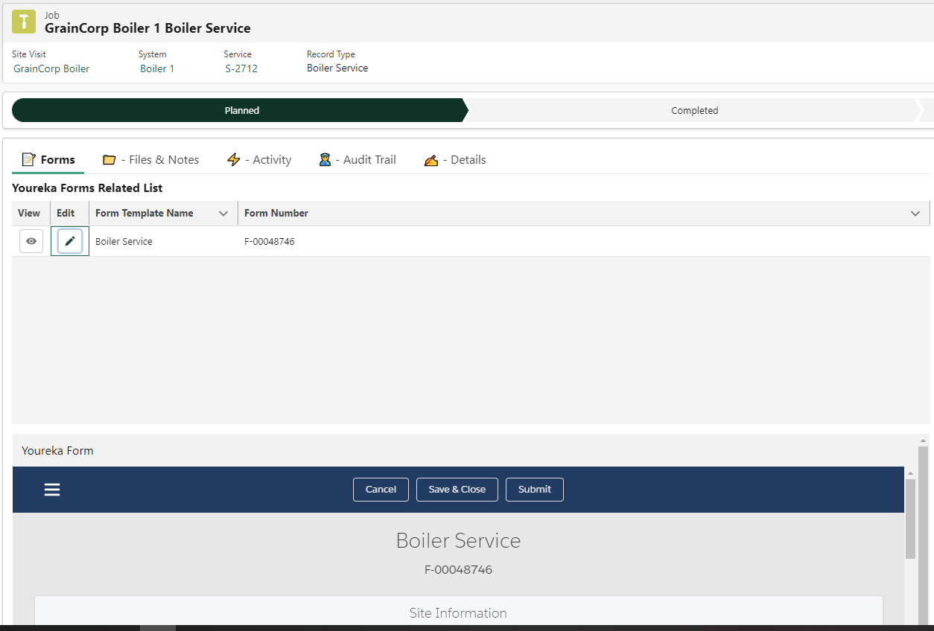
Note that this step looks a little different currently due to a bug in Youreka. They hope to have a fix available soon
Scroll

Slide 32
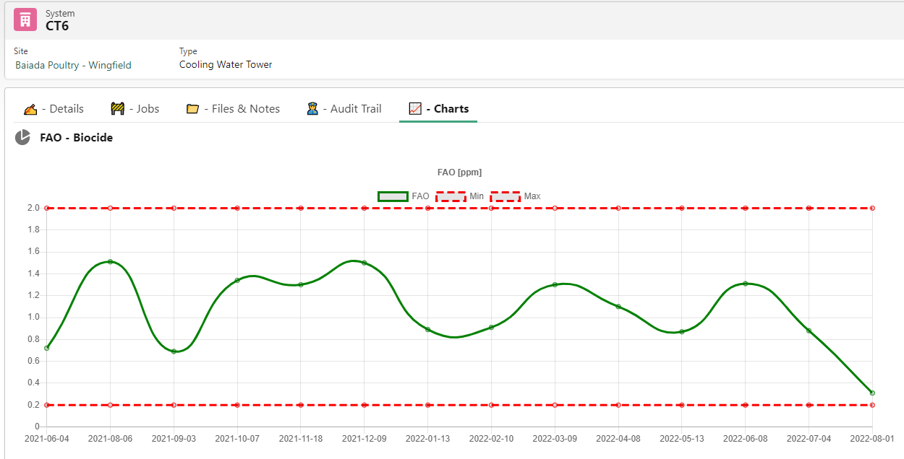
System Charts

Slide 33
Uploading Reports
Only use this for systems not covered by Youreka
Trade Waste
RO
etc

Slide 34
GIGO
Check to make sure your setup data is correct
Limits
Tests
Contacts
Weeks
Service frequency
Check your Report – Let me know if it needs to be regenerated
ALL Jobs needs to be completed – If some are not, the reports won’t be sent out until they are all done
Notes:
Chemical property limits were copy/pasted in the beginning. It’s your responsibility to check them. Once you submit the report, it will be copied to the next site visits.
SF/Youreka does not know what tests you need to perform, you need to know this and input their details. The extra tests should learn, but it’s not foolproof.
When a new contact is added the default is to add them to the email list, but they can be excluded if you want them on there just for sales or relations
The Service frequency isn’t 100% accurate on all sites and the Auto scheduler works from that. If you are new to the auto scheduler, check against your BMS printout the first month and let me know
When you resubmit a report it should generate a second PDF and you can delete the old one. I’m working on removing the old one automatically, but that’s still creating issues. The reports will be sent out 2 days later, and we don’t want to send out both.

Slide 35
Salesforce – Reports
The reports tab is NOT service report. These are reports showing us our progress and data in different fields.
The reports tab has various reports available, but feel free to contact cswart@hydroflow.com.au if you can think of different types of reports to add.

Slide 36
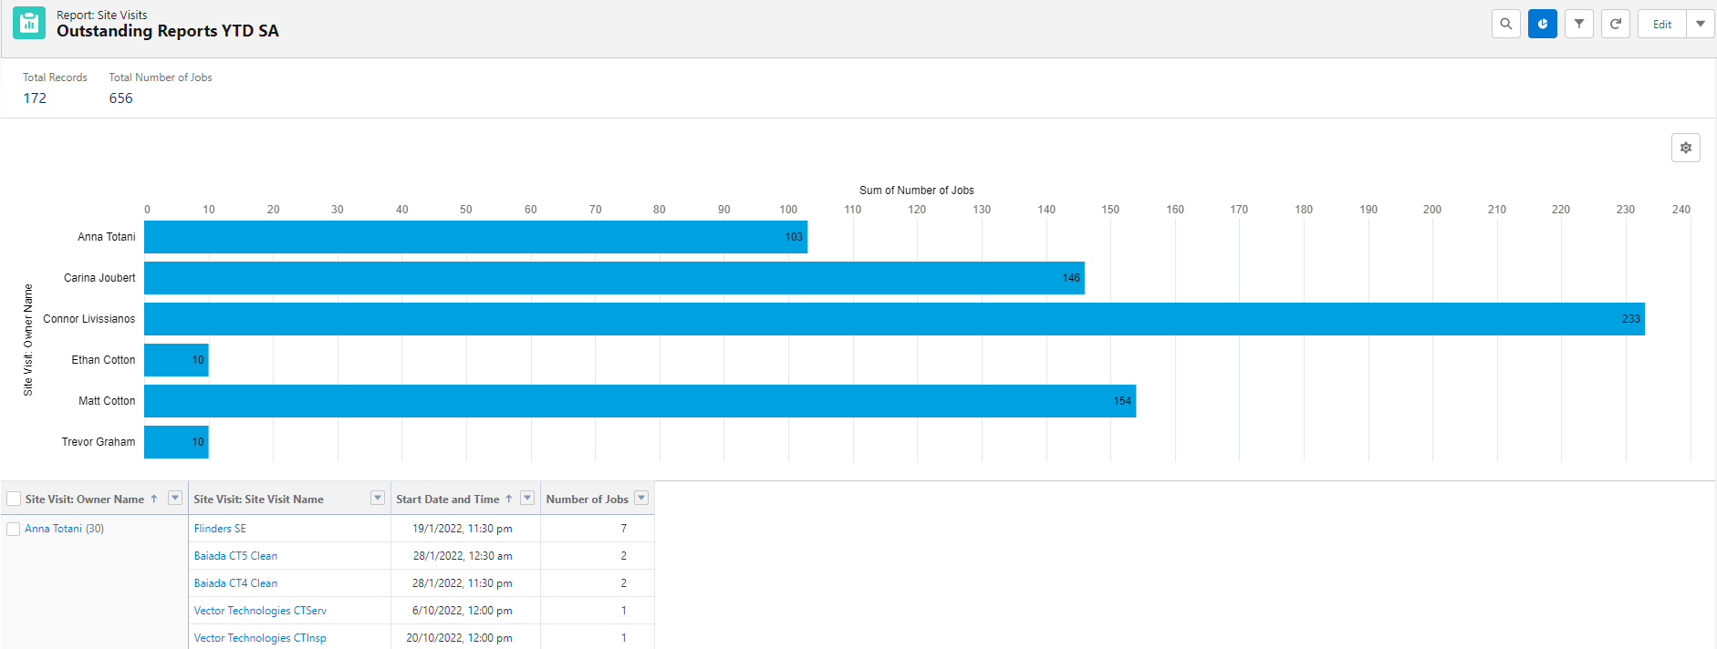
Available to area managers only, a report showing your team’s progress YTD
Find it in: Reports > All Folders > Area Manager Reports where you can add it to your favourites.
Similar report for individual users on the next slide
Notes:
Managers access only

Slide 37
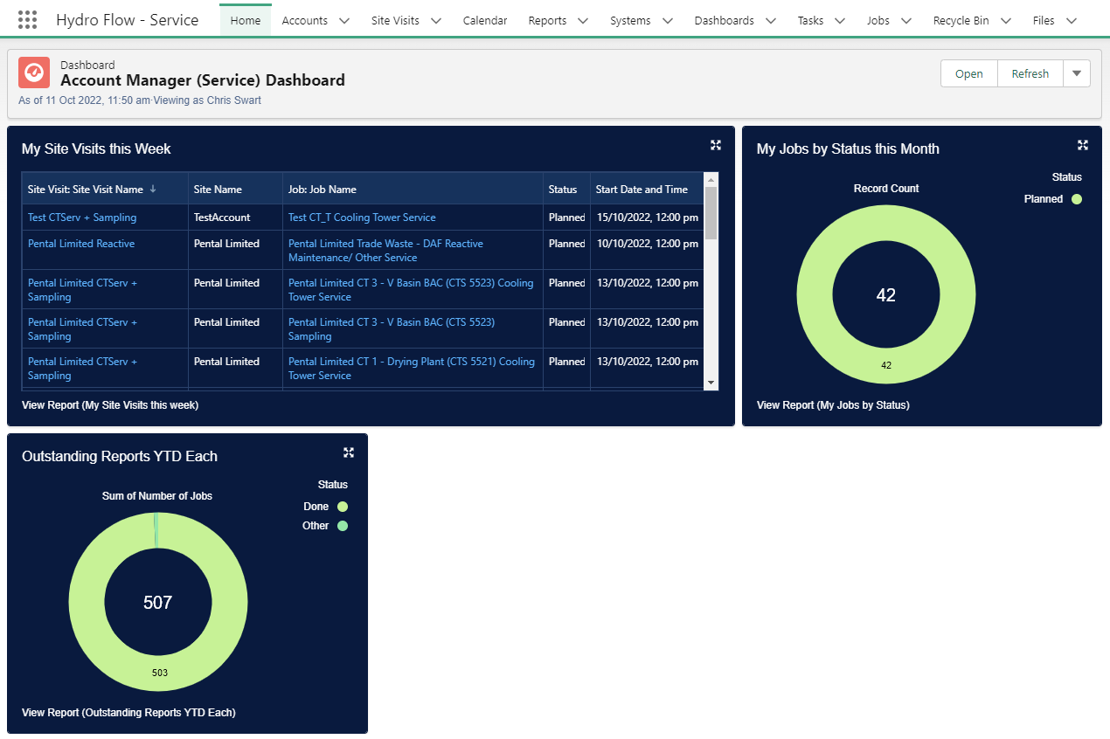
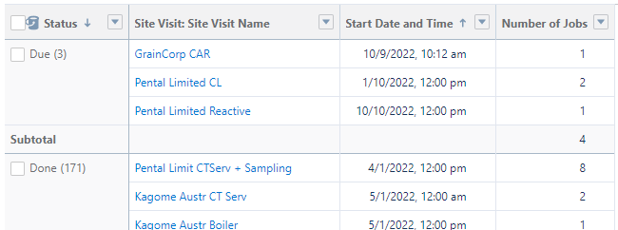
Notes:
Each individual access

